Slide 1
Temperature's prediction of US largest cities – Consequences for investments
TDI - Capstone Project – Dr. Alexandre Belli
July 27th, 2021

Slide 2



Climate Change:
Increase of temperature and heat waves frequency, duration, and intensity
> 80% of the US population lives in Urban areas.
> 300 US cities with > 100,000 inhabitants.
https://css.umich.edu/factsheets/us-cities-factsheet
In which US largest cities to invest in the future?
What are the consequences for cities and US populations?

Slide 3
Insights from data | Consequences for investors
Which large cities will see frozen temperature disappearing by 2100? | Snow management Heating, electricity consumption Winter activities/tourism
How many days per year will be above a specific temperature? | Health consequences for populations Migrations A/C Tourism, activities (sport)
What is the average, maxima, minima temperature increase? | Rethinking cities New materials (heat resistant) Human resources Green areas, freshwater access

Slide 4
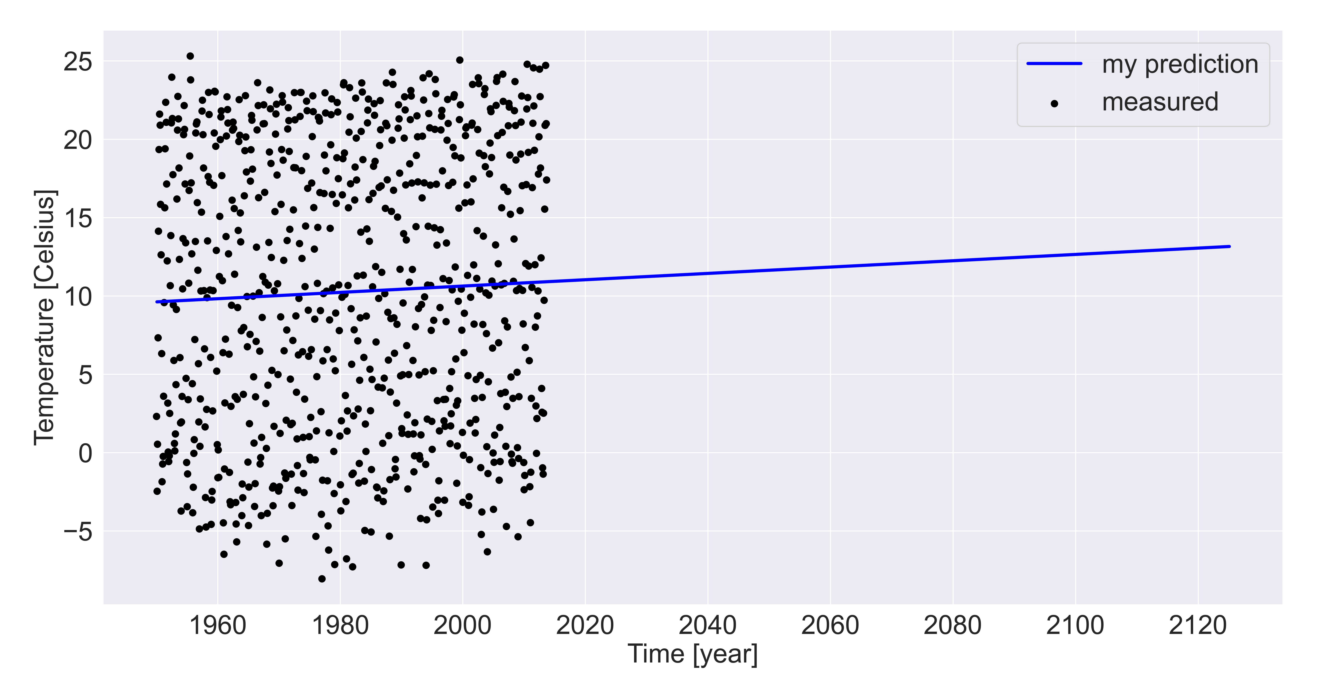
Temperature prediction for NYC
(532.8 MB – for all the dataset – cities Temperature measured from ~1750 to 2013)
Monthly data
Prediction using Linear regression on data from 1950 to 2013
Hypothesis: linear evolution of temperature
Python, Pandas, Numpy, Matplotlib, Scikit Learn
+ 2.5 C

Slide 5
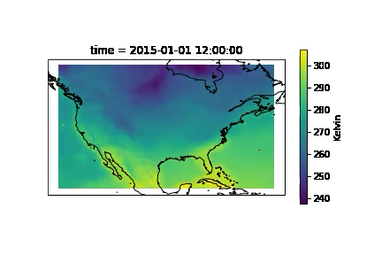
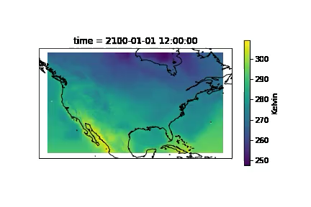
NASA NEX climate data – Global temperature predictions up to 2100 (~800 MB/year)
Selection: 2015 and 2100 (798.3 MB and 794.7 MB )
Animations
2015
2100
Global data
Python, Pandas, Numpy, Matplotlib, Xarray, Moviepy, Cartopy
Use the NASA data to study which coastal cities are at risk to be submerged by the rise of ocean’s level

Slide 6
Backup Slides

Slide 7
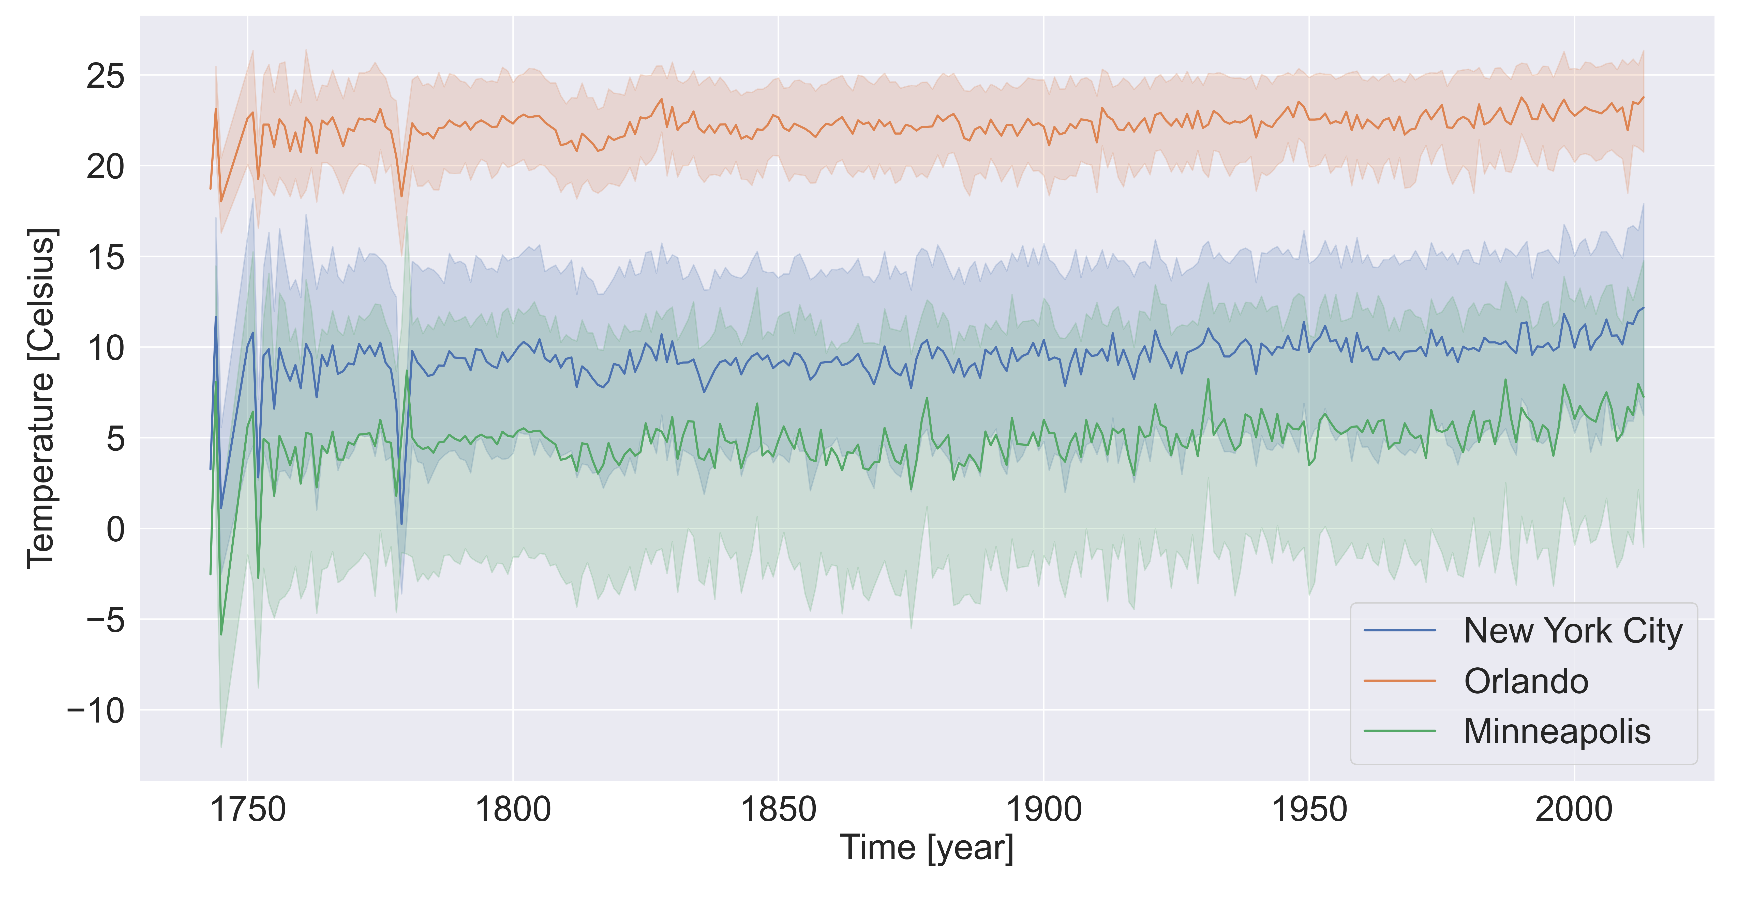
Historical temperature for cities, NYC, Orlando and Minneapolis
(532.8 MB – for all the dataset)
More precise
Machine Learning possibility
Python, Pandas, Numpy, Matplotlib, Seaborn

Slide 8
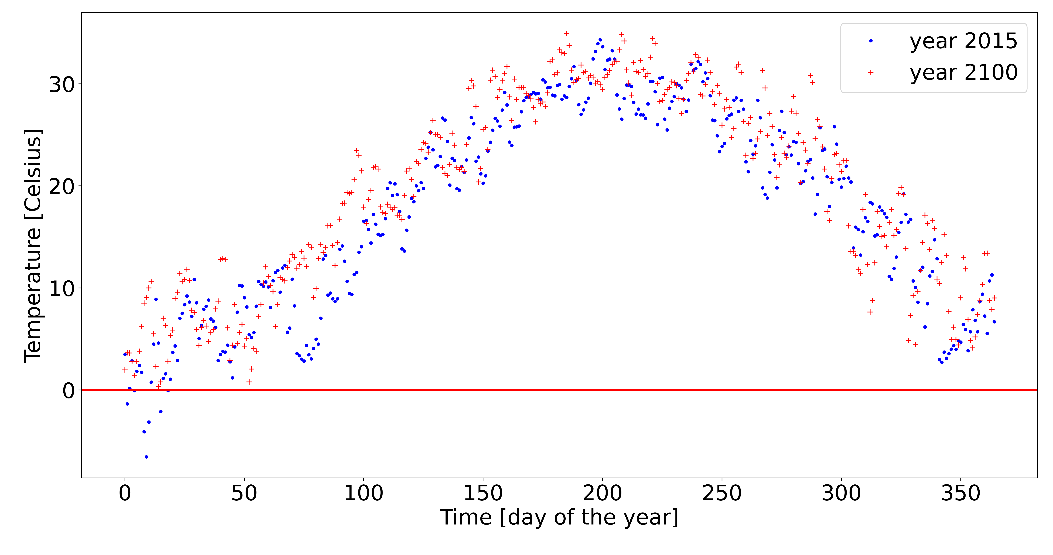
NYC
Average surface temperature according to NASA NEX models

